Slide 1
EASI exercise: who’s e-mailing? Read the e-mails and try to find out what type has written which e-mail

Slide 2
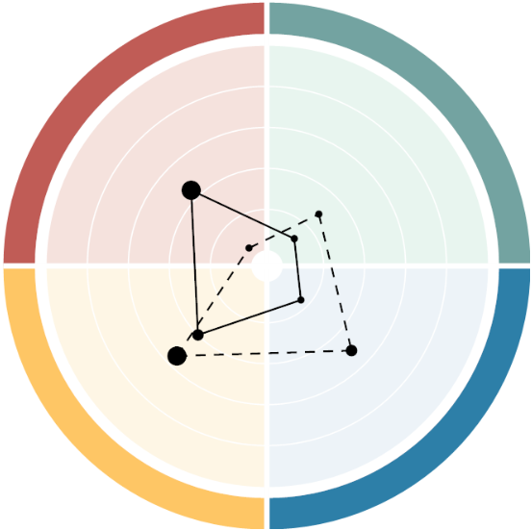
the four basic styles - behaviours
Exuberant Emotional Outgoing Influential Like to experiment Spontaneous
Sensitive Empathetic Welcoming Harmony-seeking Patient Seeking cohesion
E
S
Controlling Result-oriented Effective in decision-making Pragmatic Direct Impatient
Deliberate Systematic Conscientious Rational Critical Formal
I
A

Slide 3
E-mail 1
Dear Mrs,
For reasons that have arisen, I am emailing you to book a reconciliation meeting regarding the business plan.
More information on the matter at hand is attached.
Waiting for your appointment booking for Teams and agenda for the meeting.
Sincerely
Notes:
20 minuter

Slide 4
E-mail 2
Hi sweetie,
How are you? Last time we spoke, you were a bit down, do you feel better now?
It's important that you don't go out of your way too much and put on a lot of stress now that there is so much to do with the new business.
Please let me know if you need to talk, and I'll be happy to listen.
Oh, and you wanted us to have a meeting, so of course we'll schedule that! When would be a good time for you?
How much time do you need and does anyone else need to be in the meeting?
I can bake a nice cake that we can have with the coffee, so it will be a little extra pleasant ☺
Let me know if you are allergic to anything! Or if you are on a diet, I can make rawfood balls, if that´s better for you?
Take care!
Notes:
20 minuter

Slide 5
E-mail 3
Hi,
We must book the reconciliation meeting!
I have a slot on Tuesday between the weekly meeting and the management group meeting, send me a booking.
Bring lunch, do I need to prepare anything?
If not, you go, you got this!
Later!
Notes:
20 minuter

Slide 6
E-mail 4
Heya!!
Hope all is well!!!
I, myself just came from a customer meeting and it went really well! Lots of great ideas that flowed, and we should be able to find some new, creative way to work together!
Feels like there is SO much exciting stuff to do on this front, if we just dive in and try something new, right?
Just heard about an innovation from the US that we should be able to use in our solutions.
Anyway, we were supposed to make an appointment. What do you think about tomorrow at 11? Is half an hour enough?
See ya!
PS how was the concert this weekend by the way? SO cool that you got a seat so close to the royal couple!!! Did you talk to the guy? ☺ :D
Notes:
20 minuter

